Slide 1
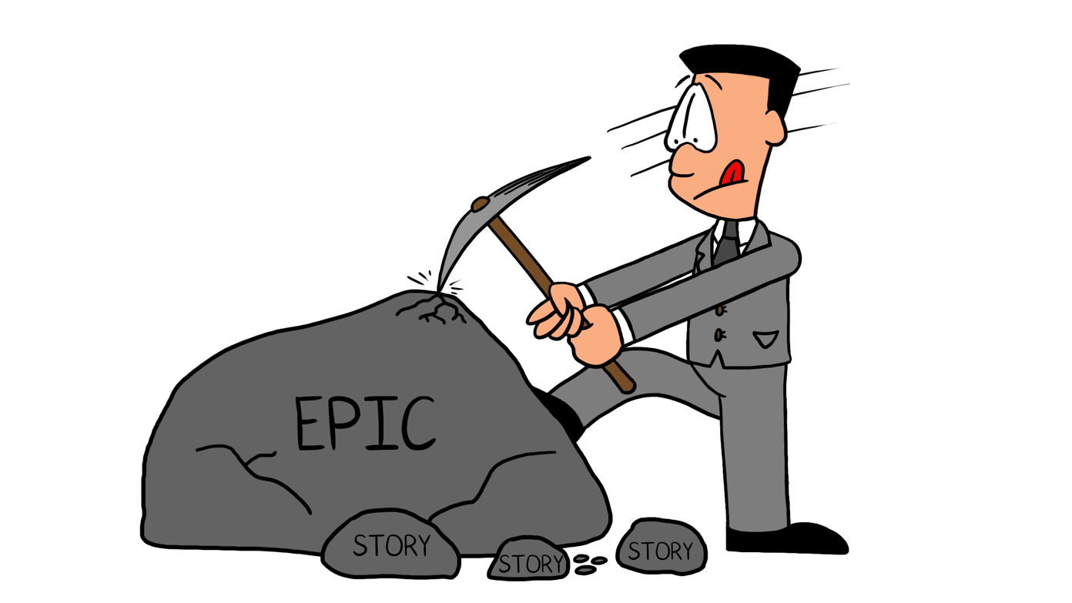
Rock Crusher Canvas V0.9
Rock Crusher Name
Date
Version
Rock Crusher Hypothesis
How to Build A Rock Crusher
Form a Rock Crusher Hypothesis. (What problem are you trying to solve through adoption of the Rock Crusher approach?)
Choose a value stream. (Where will the Rock Crusher reside?)
Identify your village. (Who will play the various Rock Crusher roles?)
Visualize your Rock Crusher. (How will you visualize the rocks flowing through the Rock Crusher?)
Establish your intake policies. (Where are the front and back doors into the Rock Crusher?)
Establish your Waste Gate policy. (What are your policies for disposing of or managing the rocks ejected through the waste gate?)
Schedule the ceremonies. (What is the cadence and attendance list for the various Rock Crusher ceremonies?)
Continuously improve your Rock Crusher. (How will you apply continuous improvement concepts to the Rock Crusher you are implementing?)
Why?
What is the value of doing this?
What problem are we solving?
Why do we think this is the solution to this problem?
Rock Crusher Metrics
Value Stream
What will we measure to know if it’s working?
Which Value Stream is the Rock Crusher associated with?
Which Steps?
Which Solutions?
The Village
Backlog Owner
Solution Owner(s)
Analyst(s)
Stakeholder(s) & Customer(s)
SME(s)
Teams
Horizons
How turbulent is your flow, and how many horizons would you need to throttle and stabilize your flow?
Intake Policy
Waste Gate Policy
How and when will we accept rocks?
How responsive must we be to our stakeholders?
How will injections change our commitment?
What is our backdoor policy?
What are the Rock Crusher WIP limits?
Do rocks have a best-before date?
What happens to ejected rocks?
Ceremony Schedule
Crusher Policy
Will we have both a tactical and strategic backlog refinement meeting?
Who needs to attend?
Who should attend?
How long? How often?
When should a Crusher be created?

Slide 2
Rock Crusher Canvas Guide V0.9
Form a Rock Crusher Hypothesis
Before you start designing your rock crusher you need to ask why? What is the problem we are trying to solve, and what outcome do we want?
Some of the problems you may be observing are
flow is impeded by a broken value streams
loss of customer focus because the backlog disconnects the team from the customer
waste resulting from overprocessing of user stories
product owner is overwhelmed
Some example Rock Crusher Hypothesis:
● Implementing the Rock Crusher will improve our focus on valuable outcomes.
● Implementing the Rock Crusher will reduce the organizational load and waste by focusing work where it is expected to be valuable and eliminating work that would have been discarded anyway.
● Implementing the Rock Crusher will result in aligned organizational objectives, so that we spend more of our development effort on the higher priority items and/or we complete more high-priority items because interfering requests have been eliminated.
● Implementing the Rock Crusher front-door and backdoor processes will improve use of team capacity, allowing us to react rapidly to emergencies and opportunities while still meeting strategic goals.
Value Stream
A value stream is simply a model of how we deliver a product or service, from a trigger event to the delivery of value to a customer
The Rock Crusher is a flow-based model of backlog management, so to build a successful Rock Crusher you must understand how value flows in your organization. This understanding starts with some deceptively simple questions:
● What do you do that creates value?
● What is the solution you offer to your customer?
● How do you as an enterprise create and deliver that solution?
If you are not fully aware of the value stream, then use the supplemental Value Stream Identification worksheet. In a pinch just agree on what Solutions (product or service ) the team delivers.
Rock Crusher Metrics
You cannot manage what you cannot measure. We have established a Rock Crusher hypothesis now we need to identify what metrics we can use to determine if its actually working
Here are some metrics you might consider:
● Total number of rocks accepted through the funnel
● Number of rocks that are identified as strategic
● Planned capacity allocated to strategic versus nonstrategic rocks
● Ratio of strategic versus nonstrategic rocks pulled through the thin pipe
● Effort spent on strategic versus nonstrategic rocks versus planned
.
The Village
The critical choice is deciding if the backlog owner and solution owner roles are played by the same individual or by different individuals. A backlog can have only one backlog owner. It may have one or more solution owners. Understanding the backlog owner - solution owner relationship is critical when building your Rock Crusher because it defines ownership roles.
After you have identified the backlog owner you must identify what support they will need. Do you need additional people to serve as analysts? Is the backlog owner also the solution owner? Does the backlog owner need to coordinate with multiple solution owners? Who are the go-to subject matter experts able to answer detailed and specific questions about their topic? Is the backlog owner also a subject matter expert, or are there other subject matter experts you need to go to with occasional questions?
Horizons
The Rock Crusher readiness Horizons are indicators of flow turbulence. An out of the box Rock Crusher has 4 Horizons. While these are based on client observations, you context may be different
.
Wishful Thinking / Big Ideas. Typically represents anything in the far off future, at least two or three quarters out. Flow is turbulent: The rocks are poorly formed and likely to change frequently, and are only moderately defined. It is not even certain if the rock will pass vetting. The rock’s scope could be very large. It is unlikely the team can size the rock beyond a coarse T-shirt sizing (S, M, L). These rocks are “pitchable” but not yet defensible.
Speculative. Flow is less turbulent but with only a moderate degree of certainty that all or part of the rock will be needed or will get done (e.g., a moderate to large epic user story). Rocks here may represent about a few weeks of work for a team. We do not expect to pull these rocks through the thin pipe for at least one or two months. The team can likely size the rock using finer T-shirt sizing (XS, S, M, L, XL). Some economic justification exists for the rock.
Forecasted Flow is significantly smoothed. There may be a fair amount of certainty that we will commit to the Rock maybe a couple of weeks to a couple of months out in the future. Rock is sufficiently well formed that a Team can reasonably size it and know if they need to split it into right sized Rocks (can be implemented in a single iteration or sprint). Rocks are “near forced rank” prioritized.
Ready. Ready” for a Team (e.g., a well-formed user story). The Rock is sufficiently well formed and right sized such that a Team can commit to delivering it within an agreed time box (e.g. an iteration or a SAFe PI). In a Kanban world, they can satisfy their service level agreement (SLA) for a Rock of this type and size. Ready Backlog Rocks are forced rank prioritized.

Slide 3
Rock Crusher Canvas Guide V0.9
Intake Policy
Intake policies establish how and when we will accept rocks. The formal or front-door intake policy sets down the rules for when the backlog owner and team will consider rocks that have arrived at the top of the funnel. For teams following capacity-based and time-boxed based methodologies like Scrum or XP this will be the usual planning and refinement meetings. For a team using a flow-based methodology like Kanban, the team will need to establish a schedule that maintains both flow and responsiveness.
Teams using Scrum or XP find their biggest challenge with handling “injections.” Most environments will have to answer these questions:
Will you even consider injections?
How responsive must you be to your stakeholders?
If you accept the injection, then how will you change your commitment?
Finally, you need to consider your backdoor policies—how you will handle direct stakeholder engagement with team members. A team needs to decide whether small backdoor efforts reduce friction in the organization and build goodwill or place the team’s sprint commitment at risk.
Waste Gate Policy
Your waste gate policies must be clear. This will eliminate the risk of zombie rocks clogging the Rock Crusher. It will also ensure that you do not prematurely bury rocks that may still have some value.
Here are some things to consider when deciding these policies:
● How much WIP is too much? Establishing WIP limits for important work stages is generally considered a best practice.
● What happens to rocks that are sent to the waste gate? This will happen at various times. Are these rocks deleted from the tool or moved to some kind of deferred or archived state?
● How will rocks be aged out? When is a rock too old to be retained? It is shocking how many teams will have stories in their backlog that are years old, with minimal likelihood they will ever be implemented. How long should a story-sized rock remain in the ready state? A quarter? A half year? A year? How about a feature-sized rock? How long should an initiative-sized rock remain in the speculative state?
Ceremony Schedule
Teams following good agile practices will already have a standing backlog refinement meeting on their calendar. What may change with the adoption of the Rock Crusher model is who is invited to that meeting and whether the team adopts a strategic/tactical refinement meeting split[1] .
What about other teams (not high-performing) Point back to chapter 8 for the backlog refinement description
Crusher Policy
How do you learn about the problem you are trying to solve?
When should a Crusher be created?
How would you specify the level of precision required for a Crusher?
How will you avoid Crusher anti-patterns?
How will you represent Crushers in your tools?
Who can create Crushers? Anyone? The Team? The Analyst?

Slide 4
Supplement - Value Stream Identification
Step 1: Identify an Operational Value Stream
Operational value streams are all the activities for delivery value into the hands of a customer, from some kind of triggering request to delivery of the product or service. A distinguishing characteristic of an operational value stream is money changes hands. An operational value stream is simply a high level happy path description of how you deliver value to customers.
How to identify an operational value stream
Identify a product group or family
Identify triggering event
Walk through from the triggering event to delivery of value
Step 2: Identify the Capabilities or Systems that support the steps in our operational value stream
What are the systems or capabilities required to implement the the operational value stream….simply what do people use to do their job?
Step 1: Identify the Development Value Stream(s)
Development value streams deliver and improve the systems or capabilities that enable the operational value streams. A distinguishing characteristic of an development value stream is ideas are converted into capabilities. Most development value streams are some variant of “design, build, test”

Slide 5
Rock Crusher
Supplemental Worksheets

Slide 6
Discussion: Your Backog: Reservoir or Flow?
Does work flow or does your backlog serve as a buffer or reservoir between business and IT?
Is your backlog more of committed coding work, or is there a mix of discovery and coding?
What is the role of the PO in your organization?
How responsive to change is your organization?
Full Day Tutorial
Have you been part of a broken value stream?
What were the symptoms of the broken value stream ( e.g. delays)

Slide 7
Exercise: The Rock Crusher Hypothesis
What Problem are you trying to solve?
Given the problems we identified in the first section of this lesson, how may adopting the Rock Crusher help mitigate those problems? To help you in writing your own hypothesis, here are a few example starter statements:
Implementing the Rock Crusher will improve our focus on valuable outcomes.
Implementing the Rock Crusher will reduce the organizational load and waste by focusing work where it is expected to be valuable and eliminating work that would have been discarded anyway.
Implementing the Rock Crusher will result in aligned organizational objectives so that we spend more of our development effort on the higher priority items and/or we complete more high-priority items because interfering requests have been eliminated.
Implementing the Rock Crusher front-door and backdoor processes will improve the use of team capacity, allowing us to react rapidly to emergencies and opportunities while still meeting strategic goals.

Slide 8
Exercise: Characterizing Your Flow
What generally is the scope of new backlog items (Rocks) entering the funnel?
All “story size”
All “epic/initiative size?”
A mix of sizes and types from initiatives, to stories to defect fixes
Can you qualitatively speculate what your crush ratio is?
All Rocks are pulled through the Thin Pipe
Most Rocks are pulled through the Thin Pipe
Some Rocks are pulled through the Thin Pipe
No Rocks are
Is this ratio appropriate for your horizon?
How do you stabilize and throttle the flow ?
When are stabilization and throttling decisions made (e.g. what meetings?)
Who makes them?
What happens to backlog items (AKA Rocks) that are throttled?

Slide 9
Exercise: The Solution
Project or Product Team?
During this tutorial we need more time for a Value Stream Identification exercise. However:
Can you Identify the solution(s) your Rock Crusher delivers?
Is your “team” product-oriented that is responsible for a set of one or more solutions, or project-oriented?
If you know your value stream, do you know which value stream steps are mapped to your backlog, or is the backlog just a “buffer” between steps?

Slide 10
Exercise: Your Backlog Owner and Solution Owner(s)
Using the Rock Crusher Canvas identify your backlog owner and solution owner.
Are they the same individual or different individuals?
If they are different individuals, are there multiple solution owners?
How do the backlog owner and solution owners coordinate and maintain alignment? Are they adequate?
What actions must you execute to set up those coordination mechanisms if they do not exist??
If they are the same individual, how does the backlog owner / solution owner maintain their connection with the team while maintaining their connection with the domain?

Slide 11
Exercise: The Other Village Members
Using your canvas, identify your:
Who are your Analysts? Is the role played by other village members (e.g., backlog owner, solution owner, team?) Or are there designated individuals playing the role? How does the analyst(s) collaborate with the team?
Who are your SMEs? What do you rely on them for? Are they part of the team or a shared service provider? Are your SMEs also Analysts?
Who are your Stakeholders and Customers? How engaged are they with the Team? Have you ever met them face to face?

Slide 12
Exercise: Rock Crusher Horizons and Implementation
How many horizons will your Rock Crusher need to Stabilize and Throttle the Flow (Wishful Thinking, Speculative, Forecasted, Committed)? More? Less?
What is the exit criteria for each of these horizons?
What is the simplest possible way you may implement these horizons?
Some Advice
Agile is a barely sufficient process - Jim Highsmith
Everything should be as simple as possible but no simpler - Albert Einstein

Slide 13
Exercise: Formulate intake policy
Front door policies
Where in your value stream do you see intake?
When / what ceremonies ?
Do we need a separate state / horizon (e.g. new) for intake prior to assessment?
Where is your work coming from, another process??
What are the types of work you intake (mountains, boulders, rocks, pebbles?) are there different policies for different work types?
Are approvals required? Threshold?
Back door policies
Will we shut the back door or allow rocks to enter through the back door?
What limitations will be place on the back door?

Slide 14
Exercise: Waste Gate Policy
The waste gate is an important differentiator between the “stack of plates” model and the Rock Crusher. What goes in must come out.
We either explicitly discard rocks during refinement or “age” rocks out.
At which ceremonies will you decide to discard a rock? What factors will you consider in deciding to discard a rock?
How will rocks be aged out? When is a rock too old to be retained?
How long should a story-sized rock remain in the ready state? A quarter? A half year? A year?
How about a feature-sized rock?
How long should an initiative-sized rock remain in the speculative state?
What happens to rocks that are sent to the waste gate? This will happen at various times. Are these rocks deleted from the tool or moved to some deferred or archived state?

Slide 15
Exercise: Backlog Refinement
TWhich of the four questions do you ask during your backlog refinement?
Who determines a Rock’s value?
How frequently do you hold backlog refinement meetings?
Do you split the refinement meeting into a strategic/tactical meeting.
Which audiences are invited to each?
Do you have informal backlog refinement sessions?
How do you currently manage situations where a significant effort must be invested in learning about a Rock (analysis and design)?
How will you represent crushers in your tool (name prefix? tag? Work item type?)
How do you handle multiple parent child generations of refinement?
Does your tooling allow multiple generations of Rocks?
If not, what happens to parents as they are split into children and refined?

Slide 16
Exercise: The Pitch Deck
We have a problem
What we are observing:
Impact / Why this is a problem:

Slide 17
Exercise: The Pitch Deck
A Solution
How adopting the Rock Crusher Model will help mitigate the problem
We need the following to start

